Slide 1




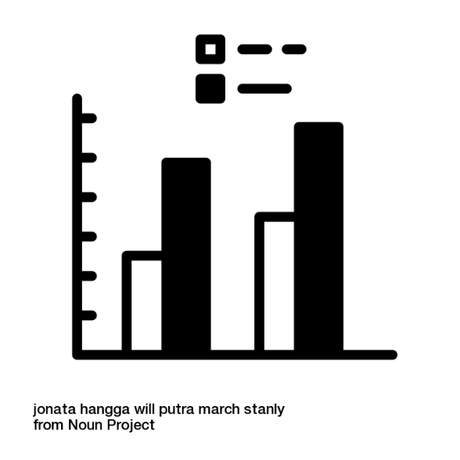
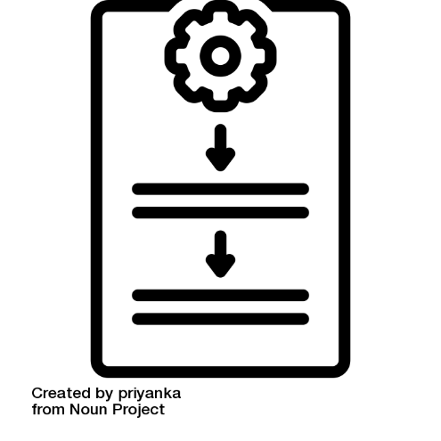
Study Design, Sampling Methods, and Statistical Analysis in Ecology
Dr Sarah Luke
University of Nottingham, UK

Slide 2

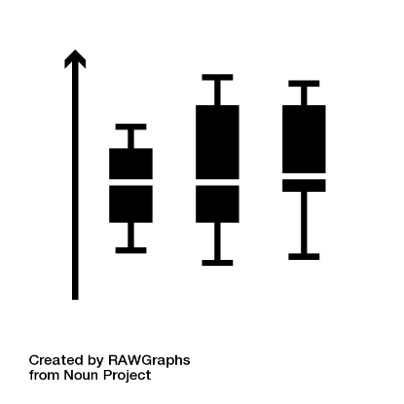
Overview
Key steps for designing a study – an introduction to the idea of the reverse planning approach
Things that need to be taken into account when we decide on sampling methods, including how to design your study to improve reliability
How to start deciding what statistical test to use – the importance of:
Your question
Your data types
Specific details about your data set
An introduction to some of the main ideas behind the statistical tests you’re likely to use
Features of some commonly used statistical tests
Packages for carrying out statistical tests

Slide 3
Overview
Key steps for designing a study – an introduction to the idea of the reverse planning approach
Things that need to be taken into account when we decide on sampling methods, including how to design your study to improve reliability
How to start deciding what statistical test to use – the importance of:
Your question
Your data types
Specific details about your data set
An introduction to some of the main ideas behind the statistical tests you’re likely to use
Features of some commonly used statistical tests
Packages for carrying out statistical tests

Slide 4




This is a statistics workshop - why start with study design?
“You can’t fix by analysis what you bungled by design…” Light, Singer & Willet (p.5)
“Design trumps analysis.” Rubin
Analysis
Your study
Study design
Light, R. J., Singer, J. D. & Willett, J. B. By design: Planning research on higher education. By design: Planning research on higher education. (Harvard University Press, 1990).
Rubin, D. B. For objective causal inference, design trumps analysis. Ann. Appl. Stat. 2, 808–840 (2008).
Slide borrowed from Alec Christie, University of Cambridge

Slide 5

Steps for designing a study – the reverse planning approach
What is the specific question?
What results are necessary to answer the questions?
What data are needed to complete these results?
What protocol is required to obtain these data?
Can the data be collected in the time available?
Modify the planning in response to time available
Create data sheets
Start and encounter reality
Sutherland 2006, Ecological Census Techniques: A Handbook
Chapter 1- “Planning a research programme”

Slide 6

1. What is the specific question?
Important to choose a suitable and specific question
Questions should…
Have a clear objective
Be practical in the time available
Not too broad
Sometimes you can break bigger questions down into smaller, related questions.
You can then bring these together to address the big question.

Slide 7
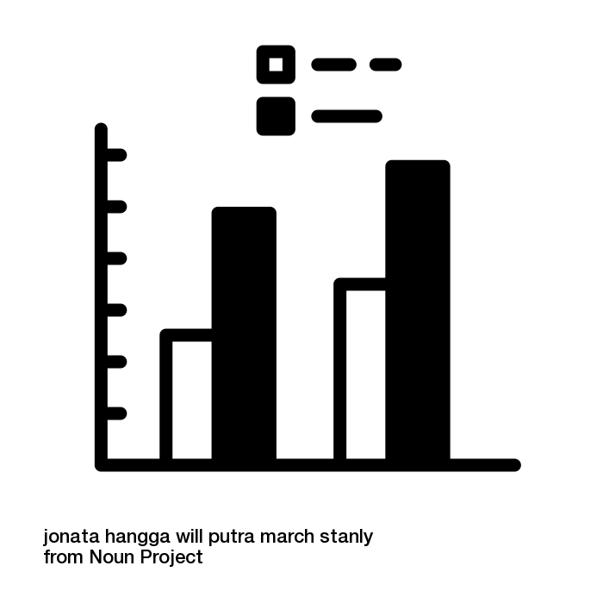
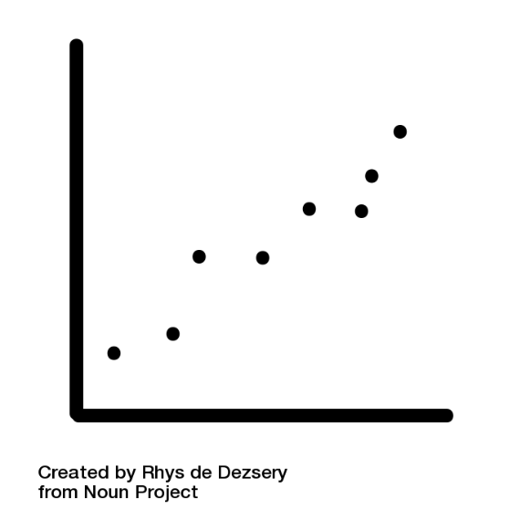
2. What results are necessary to answer the questions?
Plan the graphs, tables, and analyses that you will need to answer your question
This forces you to think about what you are trying to achieve, and what data you will need to collect to get the answers you want
Sketch graphs
What type of data do you have (e.g. continuous, categorical, spatial, etc.) and so what type of figure/table is most appropriate
Which variable will be on each axis?
Plan statistical tests

Slide 8


3. What data are needed to complete these analyses?
How many data points will you need to complete your analyses and answer your questions effectively?
Depends on how strong the relationship is that you’re investigating, and how much variation there is
If the patterns are likely to be strong and consistent then a smaller number of samples will be needed
If differences are small and variation between samples are large then more samples will be needed to be sure of any differences that are occurring
Think about time and feasibility – re-assess the scope of your questions if necessary

Slide 9
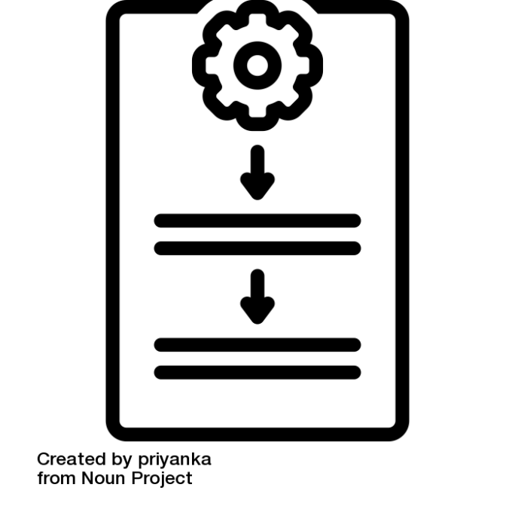
4. What protocol is required to obtain these data?
Plan a protocol before you start collecting data
Protocol = step by step “recipe-like” methods for how you will collect your data
Do preliminary testing
Check that your planned methods will work, and how long they take
5. Can the data be collected in the time available?
Be realistic, and allow for delays
6. Modify the planning in response to time available
Re-assess the scope of your questions, if necessary

Slide 10

4. What protocol is required to obtain these data?
Plan a protocol before you start collecting data
Protocol = step by step “recipe-like” methods for how you will collect your data
Do preliminary testing
Check that your planned methods will work, and how long they take
7. Creating data sheets
Helps to clarify thinking about protocol design and timing – use them in your preliminary testing
Safer than notebooks

Slide 11
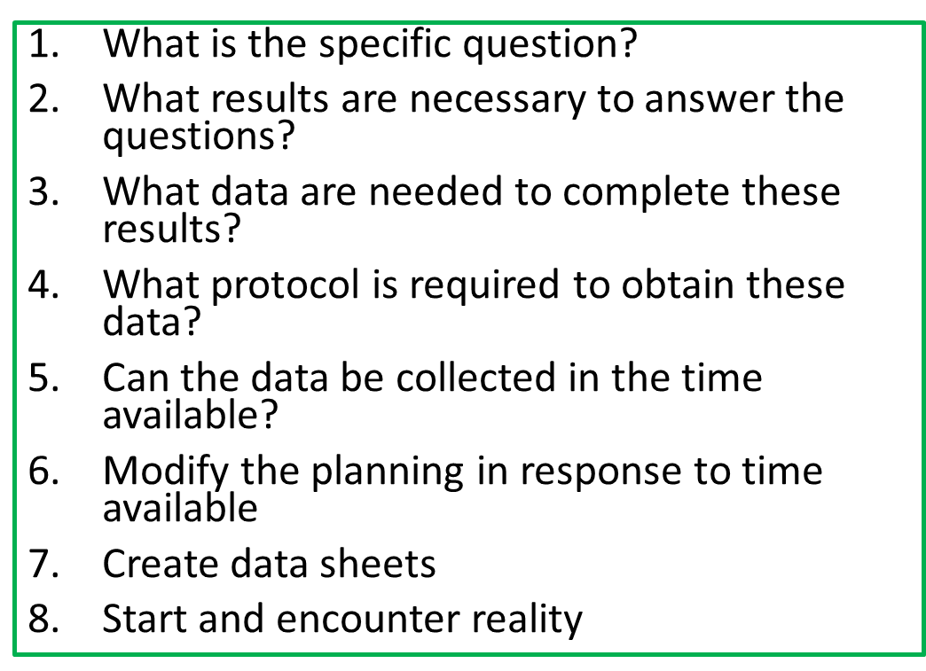
8. Start and encounter reality
Things not working
Taking longer than you thought
You’ve noticed something really interesting that it would be good to follow-up on further
Rigidly sticking to plans unlikely to be effective
Spontaneous changes in plan also unlikely to be effective!
Quickly run through the reverse planning process again to adjust ☺

Slide 12
Overview
Key steps for designing a study – an introduction to the idea of the reverse planning approach
Things that need to be taken into account when we decide on sampling methods, including how to design your study to improve reliability
How to start deciding what statistical test to use – the importance of:
Your question
Your data types
Specific details about your data set
An introduction to some of the main ideas behind the statistical tests you’re likely to use
Features of some commonly used statistical tests
Packages for carrying out statistical tests

Slide 13

What are we trying to do in a ‘study’?
Understand a pattern or phenomenon
Answer a question in the most efficient way
Usually a snapshot, or a sample – we can’t possibly find out everything about everything in a population/site
Collecting enough data to answer the question as reliably as possible, within the bounds of the resources available

Slide 14
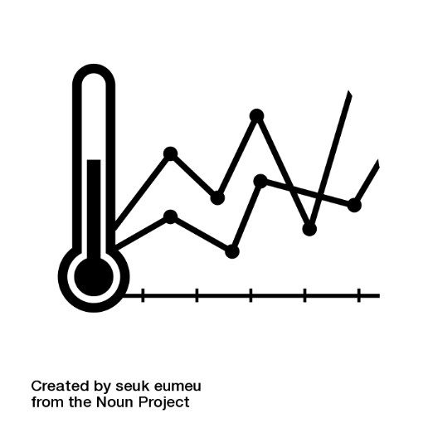
Types of study in ecology
Descriptive natural history –
E.g. describing new species, describing new interactions, describing how the world was in the past (paleoecology)
Provides essential information to support hypothesis testing studies
Often give ideas that need to be tested in follow-up experimental studies (Type 2 studies, below)
Hypothesis testing –
E.g. asking questions about emerging problems, human impacts, effects of changing environmental conditions
Involves predictions about biological or physical mechanisms.
About assessing the fit of a model.
Future projections –
E.g. relating to climate change
Based on a set of assumptions, and models developed using Type 1 and Type 2 studies, above
Based on thoughts from a blog by Charley Krebs and Judy Myers, https://www.zoology.ubc.ca/~krebs/ecological_rants/category/experimental-design-in-ecology/

Slide 15
A focus on hypothesis testing
Hypothesis testing
Observational studies – can show correlations between variables which can help lead you towards a mechanism that involves cause and effect
Experimental studies – to be certain about cause and effect mechanisms you need to carry out an experiment
* Experiments are very valuable, but difficult to do for many ecological questions, so observational studies are a commonly used approach and can still give us lots of valuable information *

Slide 16


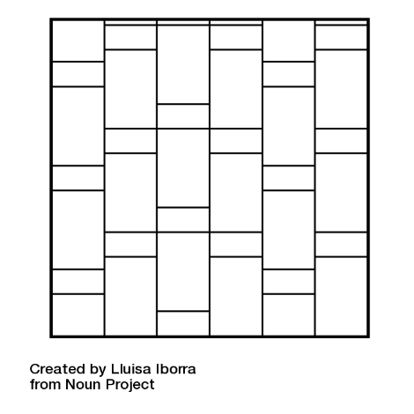
Key things to consider when deciding how to sample
Reliability
Depends on precision and accuracy
Resources
Precision can be increased by collecting more data
Need to think carefully about the balance of precision vs. costs
Precision –
How similar repeated estimates are to each other
Accuracy –
how close the estimate is to its true value, on average
i.e. how small the bias of the estimate is
Design
Accuracy can be increased by minimising bias
Need to think carefully about sampling design

Slide 17


Designing your study to improve reliability
Determining all the sampling units in a sampling frame
Replication
Ensuring samples are representative

Slide 18



Designing your study to improve reliability
Determining all the sampling units in a sampling frame
So you know what the ‘population’ is within which you will choose your sample
E.g. if you’re sampling fish in pools in a forest, you need to know where all the pools are (sampling units) within the forest (sampling frame)
Replication
Ensuring samples are representative

Slide 19
Designing your study to improve reliability
Determining all the sampling units in a sampling frame
Replication
At the same site - Sampling each sampling unit once, might give an imprecise estimate for that unit, at that time point.
E.g. some fish might not be caught in the net
Or might give an imprecise estimate for that unit over a range of time points that you’re interested in.
E.g. sampling a pool at one time of the year, might give a different result from at another time of year
At different sites - Sampling just one sampling unit gives an imprecise estimate for the whole study population. To increase precision, you need to sample more sampling units
E.g. sampling more of the pools in the forest
Beware of pseudoreplication!
Multiple measurements of the same pond are not independent replicated samples
Ensuring samples are representative

Slide 20
Designing your study to improve reliability
Determining all the sampling units in a sampling frame
Replication
Ensuring samples are representative
To avoid bias, samples must be representative of the whole population
Random sampling, or stratified random (i.e. random within clear cohorts, e.g. random chosen small ponds AND randomly chosen large ponds)
According to both time and space (i.e. avoid regular sampling)

Slide 21
Designing your study to improve reliability
If it’s possible to conduct an experiment, you will also need to consider:
Treatments – what these will be to address your question
Controls – ideally, identical in all ways except for absence of the treatment
Randomisation of allocation to different treatments – to help remove the effect of pre-existing differences
Sampling before and after a treatment begins – to be able to account for pre-existing differences
Replication
Treatment
Control
* We don’t have time to go into more detail about these aspects of experimental design but please feel free to discuss with us later, if that’s helpful *

Slide 22

Key approaches to sampling/surveying organisms
Organisms
Which, where, what, when, how?
Three main approaches for organisms:
Complete count
Counting some individuals and estimating the detectability of individuals, in order to get an estimate of total population
Obtaining an index of the population, i.e. a measure that is related to population size, but is not a complete estimate of the actual population size
E.g. Number of animals seen during a certain time period, or whilst walking along a transect of a set distance
For ecosystem functions:
Examples of ecosystem functions include - decomposition, pollination, predation, pest control, carbon capture, herbivory
Also typically index-based - very difficult/impossible (?) to fully quantify extent of ecosystem functions
Often have an experimental/observational element - in order to determine the role that a particular organism plays in a process
Ecosystem functions or processes
Which, where, what, when, how?

Slide 23

Key approaches to measuring environmental variables
Environmental variables
Which, where, what, when, how?
Key things to think about:
The importance of measuring environmental variables
They give context - You want your audience to be able to picture the environmental context in which your organism/ecosystem function data have been collected
They give explanations - the environmental variables are often key explanatory variables for the patterns in organisms/ecosystem functions that you are observing. They are therefore often key to your analyses, and to answering your questions
They are often key to management strategies – e.g. conservation action to help increase the organisms/ecosystem function you are interested in may depend on manipulating particular environmental conditions
Knowing what to measure and where
How to measure environmental variables

Slide 24
Key approaches to measuring environmental variables
Environmental variables
Which, where, what, when, how?
Key things to think about:
The importance of measuring environmental variables
Knowing what to measure and where
Avoid falling into the trap of measuring everything - don’t just measure things because you can, or because others have
What to focus on - think about how the organisms that you are interested in perceive and use their environment, and also your questions
Think about scale – how does your scale of environmental measurements match up to your organism/ecosystem function data? Is there a close enough match?
How to measure environmental variables

Slide 25
Key approaches to measuring environmental variables
Environmental variables
Which, where, what, when, how?
Key things to think about:
The importance of measuring environmental variables
Knowing what to measure and where
How to measure environmental variables
Lots of methods and equipment available that differ in terms of precision, practicality, and expense
Think about equipment and time available

Slide 26
Overview
Key steps for designing a study – an introduction to the idea of the reverse planning approach
Things that need to be taken into account when we decide on sampling methods, including how to design your study to improve reliability
How to start deciding what statistical test to use – the importance of:
Your question
Your data types
Specific details about your data set
An introduction to some of the main ideas behind the statistical tests you’re likely to use
Features of some commonly used statistical tests
Packages for carrying out statistical tests

Slide 27



Which statistical test?
Not an exact science – there are often several ways that data can be analysed
Key factors to consider:
Your question, i.e. hypothesis based or not, test of difference or relationship
Your basic types of data, i.e. numeric (continuous, discrete)/categorical (ordinal, nominal), and which are predictors/responses (if appropriate)
More specific details about your data set, including quantity of data, how balanced your sample sizes are across groups, the distribution of your data (e.g. does it follow a normal ‘bell curve’ distribution, or another distribution), if you collected data before-after in an experiment
*Producing plots of dummy data before you begin data collection, and also rough plots of your real data as soon as you collect it can help to think through all of this*

Slide 28
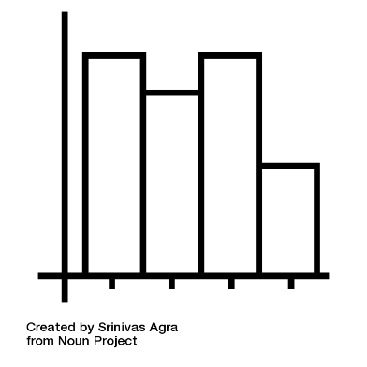
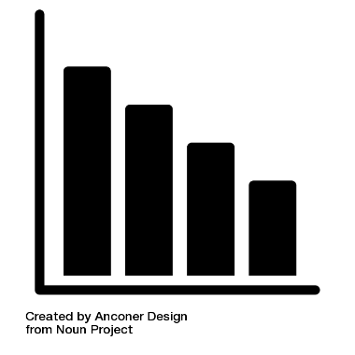
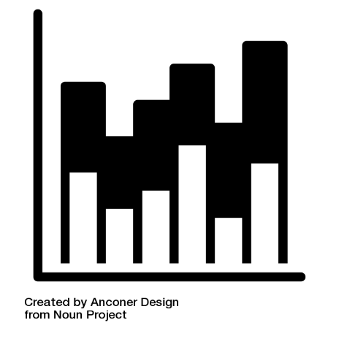
Which statistical test? - plot your data to help think all this through
Some common types of plots in ecology:
Showing the distribution of a single response variable
Box plot – distributions of numeric data, often across multiple groups (e.g. spread of tree heights in different forest treatments)
Histogram – distributions of numeric data, for a single group (e.g. spread of tree heights within a single forest treatment)
Bar chart – shows the value held by each of multiple categories (e.g. mean tree height in different forest treatments)
Stacked bar chart – values held by multiple categories within multiple categories (e.g. number of trees of each species in different forest treatments)
(Sometimes pie charts – but it can be difficult to read/compare the values of the pieces of pie, and so they are not used very commonly in ecology publications)

Slide 29
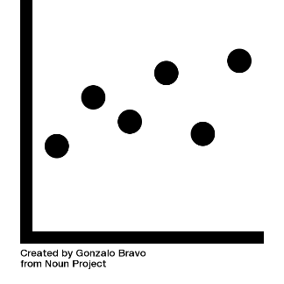
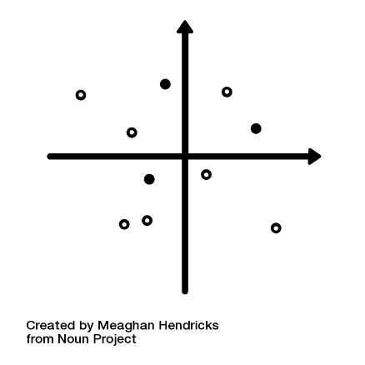
Which statistical test? - plot your data to help think all this through
Some common types of plots in ecology:
Comparing two (or three) continuous variables
Scatterplots (or 3D scatterplots)
E.g. Tree height plotted against annual rainfall
E.g. Tree height plotted against annual rainfall and level of fertiliser used
Comparing multiple variables against multiple variables, e.g. community
Ordinations
E.g. Tree community composition against multiple environmental conditions

Slide 30
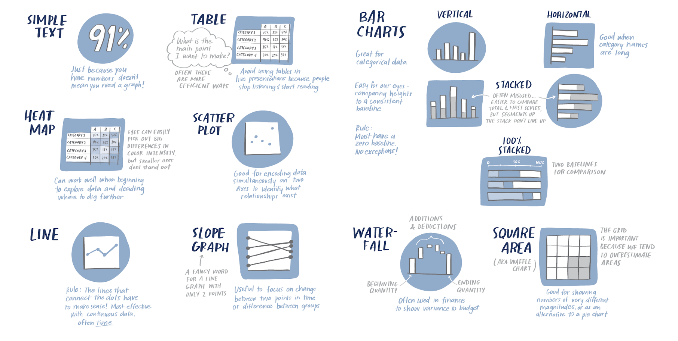
Which statistical test? - plot your data to help think all of this through
Illustrations by Catherine Madden, taken from https://www.storytellingwithdata.com/blog/2021/4/6/how-do-i-know-which-graph-to-use

Slide 31
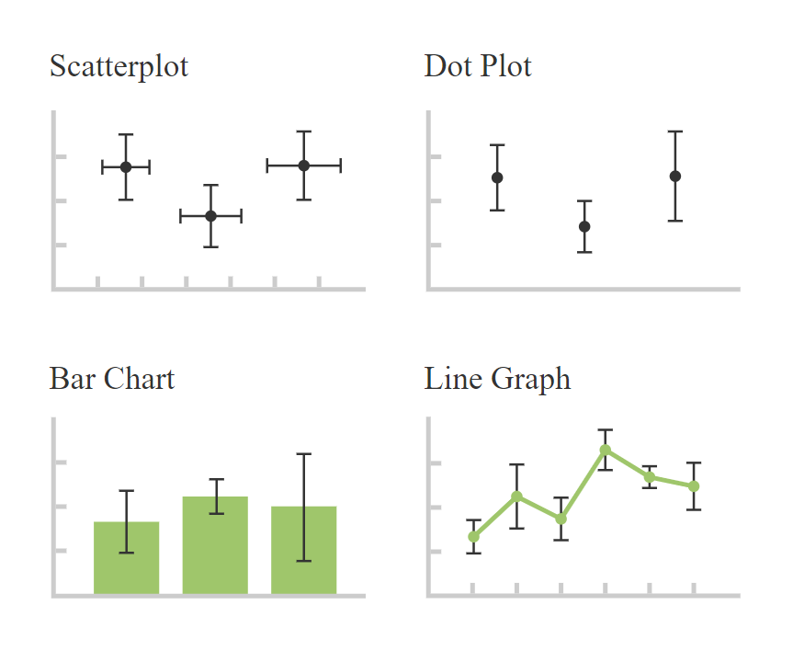
Which statistical test? - plot your data to help think all of this through
E.g. scatterplot showing annual rainfall at different sites = no trend line
Features you should consider adding to plots:
Error bars – added to plots where points/bars represent summaries (often means) of multiple values, and so it is helpful to show the variability of the data behind that value. Need to state clearly which type of variability measure is shown, e.g. standard deviation, standard error of the mean, or confidence interval
Sometimes raw data points are shown in the background too/instead
Regression line (line of best fit) – for scatterplots. Often a straight line, but can be quadratic, exponential, logistic etc.
Trend line – for time series data. Points at successive time intervals are joined with straight lines. Only join points on this type of graph where there is non-independence between points. Don’t join independent points on scatterplots.
E.g. line graph showing monthly rainfall at the same site during a year = use trend line
https://datavizcatalogue.com/methods/error_bars.html

Slide 32

Which statistical test? – it depends on your question
Key factors to consider:
Your question
Your basic types of data
More specific details about your data set
1) For describing data sets:
Descriptive statistics = Used to summarise data sets.
e.g. central tendency – mean, median, etc)
indication of the spread of those values (dispersion – range, variance, standard deviation)
2) For hypothesis testing:
Tests of difference = Used to test whether one group is different from another, or different from expected
Tests of relationships = Used to test whether there is an association between one variable and another
Correlation = no assumption of causation
Regression = cause-effect relationship is implied – there is a biological explanation for the linkage between them
3) For data investigation:
Exploratory data analysis methods = to understand data further, and explore large data sets, or understand the spread of data further
E.g. visualisation methods such as ordination

Slide 33

Which statistical test? - it depends on your types of observations/data
Key factors to consider:
Your question
Your basic types of data
More specific details about your data set
Numeric variables = quantitative variables
Continuous
Discrete
Categorical variables = qualitative variables, that describe a characteristic of a data unit, i.e. what type, or which category.
Ordinal
Nominal
Predictor vs. response variables / Independent vs. dependent variables

Slide 34

Which statistical test? - more specific details about your data set
Key factors to consider:
Your question
Your basic types of data
More specific details about your data set
“Checking assumptions” – do your data meet the requirements/have the assumed set of qualities for conducting a particular statistical test (i.e. for applying a particular model)?
Some example assumptions of tests that you might encounter
Independence of observations – your measurements are true independent replicates, rather than repeated measures of the same individual or location
Continuous data are normally distributed – when you plot your data their distribution approximates a bell-shaped curve, with most of the observations having a middling value, and very few values that are very low and very high
Equal variance – the variability of data around the mean is the same for groups that you are comparing, or across the range of predictor values
Residuals are normally distributed – if you plotted the difference from the mean for each data point, their distribution would be a bell-shaped curve
* Dytham’s “Choosing and Using Statistics” gives a useful list of assumptions of different tests, p 282 (3rd Edition) *

Slide 35
Which statistical test? - more specific details about your data set
Key factors to consider:
Your question
Your basic types of data
More specific details about your data set
“Checking assumptions” – do your data meet the requirements/have the assumed set of qualities for conducting a particular statistical test (i.e. for applying a particular model)?
Parametric vs. non-parametric tests:
Parametric –
Make assumptions about the form of the data, including that variables follow known distributions – usually the normal distribution
If data meet these assumptions, then it’s best to use these tests because they tend to be more powerful
Non-parametric –
Few assumptions. Require little or no knowledge of the distribution of the data, and are usually rank-based
Generally less powerful, but safer – can be used when data don’t meet assumptions for parametric tests
But sometimes no non-parametric options available for more complex questions
Many parametric tests have non-parametric equivalents (e.g. T-Test and Mann-Whitney U; ANOVA and Kruskal-Wallis)

Slide 36
Which statistical test? - more specific details about your data set
Key factors to consider:
Your question
Your basic types of data
More specific details about your data set
“Checking assumptions” – do your data meet the requirements/have the assumed set of qualities for conducting a particular statistical test (i.e. for applying a particular model)?
If assumptions are not met, there are several things you can do (Dytham, p284):
Data could be transformed (e.g. logged) to make them suitable for the test
An alternative test could be used that has different assumptions
The hypothesis could be reframed to allow a different test to be used
Violation of the assumptions could be ignored totally but the results regarded with caution
No test carried out at all, and just descriptive tests presented
* Careful planning with preliminary/dummy data can help to resolve these issues before full data collection is completed, therefore giving greater options for changes in sampling design *

Slide 37
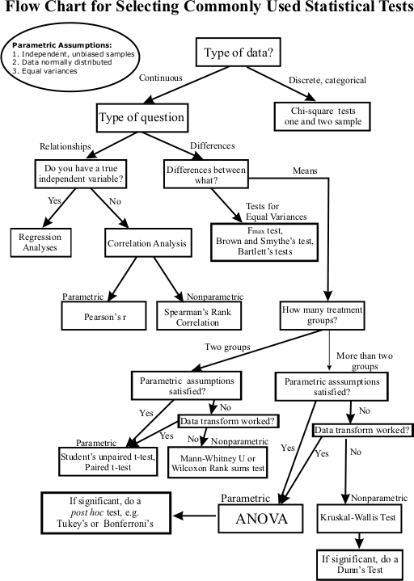
Which statistical test? - decision trees/flow charts
Key factors to consider:
Your question
Your basic types of data
More specific details about your data set
Also, e.g. key in Chapter 3 of Dytham “Choosing and Using Statistics” book
These can help to give an overview of options, and a starting point for which tests might be appropriate for your data
You should then read more about the test, what type of question it is appropriate for, the type of data its appropriate for, its assumptions, and also how to carry it out in R
http://abacus.bates.edu/~ganderso/biology/resources/statistics.html

Slide 38
Overview
Key steps for designing a study – an introduction to the idea of the reverse planning approach
Things that need to be taken into account when we decide on sampling methods, including how to design your study to improve reliability
How to start deciding what statistical test to use – the importance of:
Your question
Your data types
Specific details about your data set
An introduction to some of the main ideas behind the statistical tests you’re likely to use
Features of some commonly used statistical tests
Packages for carrying out statistical tests

Slide 39

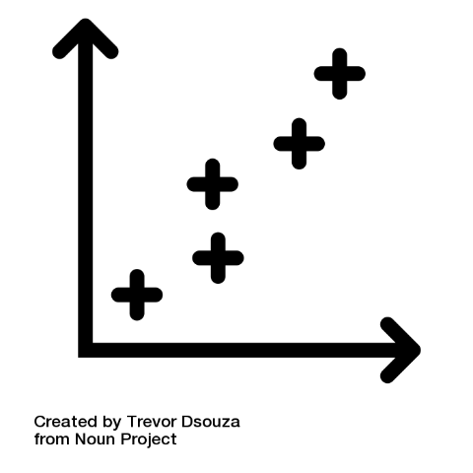
Brief intro to some common statistical tests - an overview of hypothesis testing approaches
2) For hypothesis testing:
Tests of difference = Used to test whether one group is different from another, or different from expected
Tests of relationships = Used to test whether there is an association between one variable and another
Correlation = no assumption of causation
Regression = cause-effect relationship is implied – there is a biological explanation for the linkage between them
Key ideas in frequentist hypothesis testing:
Null hypothesis, H0 - a starting point for investigations. Typically this starting point is that no difference exists, no relationship exists, or that nothing has changed over time.
Alternate hypothesis, H1 – e.g. two sample means are not equal
Test statistics
P-values
Effect size

Slide 40
Brief intro to some common statistical tests - an overview of hypothesis testing approaches
2) For hypothesis testing:
Tests of difference = Used to test whether one group is different from another, or different from expected
Tests of relationships = Used to test whether there is an association between one variable and another
Correlation = no assumption of causation
Regression = cause-effect relationship is implied – there is a biological explanation for the linkage between them
Key ideas in frequentist hypothesis testing:
Null hypothesis, H0, and alternate hypothesis, H1
Test statistics
Hypothesis testing-based tests will calculate a test statistic (e.g. t-value, z-value, F-value, X2-value) which provides a numerical summary of an observed data set based on its central tendency, variation, sample size, and number of predictors in your statistical model
Often it’s the pattern in data (e.g. correlation between variables or difference between grouped) divided by the variance in the data (i.e. standard deviation)
Very high or low test statistics typically indicate that rejection of the null hypothesis is likely
P-values
Effect size

Slide 41
Brief intro to some common statistical tests - an overview of hypothesis testing approaches
2) For hypothesis testing:
Tests of difference = Used to test whether one group is different from another, or different from expected
Tests of relationships = Used to test whether there is an association between one variable and another
Correlation = no assumption of causation
Regression = cause-effect relationship is implied – there is a biological explanation for the linkage between them
Key ideas in frequentist hypothesis testing:
Null hypothesis, H0, and alternate hypothesis, H1
Test statistics
P-values
Comparison of the test statistic value that was calculated from your sample, with the predicted distribution if null is true, allows you to make a judgement about how likely it is to be true
P-values help with this and provide a universal way across multiple types of test for us to assess whether we should reject null
P-value = the probability of seeing a result that’s at least as extreme as the test statistic, if the null hypothesis is true
In ecology we typically apply 0.05 (5%) as the critical level for rejection of the null hypothesis, with smaller P-values indicating greater confidence in rejecting the null hypothesis
Effect size

Slide 42
Brief intro to some common statistical tests - an overview of hypothesis testing approaches
2) For hypothesis testing:
Tests of difference = Used to test whether one group is different from another, or different from expected
Tests of relationships = Used to test whether there is an association between one variable and another
Correlation = no assumption of causation
Regression = cause-effect relationship is implied – there is a biological explanation for the linkage between them
Key ideas in frequentist hypothesis testing:
Null hypothesis, H0, and alternate hypothesis, H1
Test statistics
P-values
Effect size
Don’t forget effect sizes! i.e. how big a difference is there in real money!
Easy to get carried away with significant p-values, and not stop to think whether the difference you have ‘found’ is biologically meaningful, interesting, or relevant.
E.g. you could find that there was a significant difference in number of beetles found in one site compared with another, but if this is an average of 5 per transect compared with 7, is it likely that this is an ecologically important difference? – seems likely that this beetle is similarly rare in both and so not playing a substantial role in functions.

Slide 43

Brief intro to some common statistical tests - examples of tests of difference
Two-Sample T-Test
For testing for differences in the means of two groups
Type of data = categorical predictor, and continuous response
Test statistic = t-value
Null = no differences between the means of groups
Ecology example:
Testing whether vegetation grows taller on the verges of B-Roads or A-Roads
Predictor = road type
Response = vegetation height
Null hypothesis = no difference in vegetation height
Mann-Whitney U
A non-parametric test equivalent to a Two Sample t-test
Makes no assumption about the distribution of the population
Paired T-Test
For if your samples are connected in some way, e.g. collecting data twice from the same individual

Slide 44
Brief intro to some common statistical tests - examples of tests of difference
One-way ANOVA
For testing for differences in the means of multiple groups
Type of data = categorical predictor, and continuous response
Test statistic = F-value
Null = no differences between the means of groups
Follow with a posthoc test (e.g. Tukey test) to see where differences lie between groups
Ecology example:
Testing how temperature varies with microhabitat – underground, soil surface, understory, canopy
Predictor = microhabitat type
Response = temperature
Null hypothesis = temperature is equal
Kruskal-Wallis
A non-parametric test similar to one-way ANOVA, based on ranks
Used for comparing two or more independent samples of equal or different sample size
Like Mann-Whitney U test but can test more than two groups
Can test where the differences lie between pairs of groups by using Dunn’s test, or pairwise Mann-Whitney tests with Bonferroni corrections

Slide 45
Brief intro to some common statistical tests - examples of tests of difference
Chi-squared test, one sample
Used to compare the observed frequencies in each response category to the expected frequency if the null hypothesis were true
Type of data = categorical predictor, and discrete response
Test statistic = X2-value
Null = No difference between the observed and the expected frequencies
Ecology example:
Testing whether male dragonflies visit a pond more frequently than female dragonflies
Predictor = male/female
Response = count of the number of visits
Null hypothesis = visits are equal
Chi-squared test, two sample
Testing whether two data samples come from the same distribution
Based on binned data, and testing whether the number of points within each bin is similar or not

Slide 46
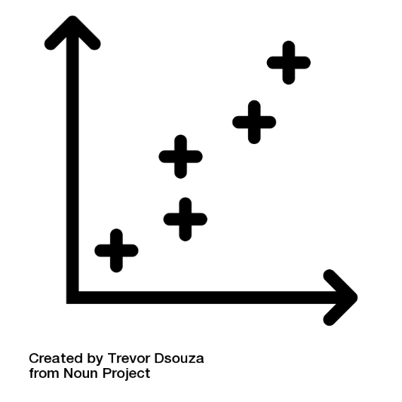
Brief intro to some common statistical tests - examples of tests of relationships
Simple linear regression
Type of data = continuous predictor, and continuous response
Test statistic = t-value
Null = no relationship between the predictor and response
But important to also look at the R2 value, which shows the tightness of the fit of the data around the trend line, and the gradient of the line
Ecology example:
Testing whether there is a relationship between temperature and tree height
Predictor = temperature
Response = tree height
Null hypothesis = tree height is the same across all temperatures
Multiple linear regression
Special case of simple linear regression where there are more than one predictor variables, and one continuous response

Slide 47
Brief intro to some common statistical tests - examples of tests of relationships
Generalised linear models (GLMs)
A regression based framework for modelling response variables that are bounded close to the range that you’re working with (e.g. counts, where it’s likely there will be lots of zeros), or variables that are discrete
Changes in the link function used within the model take account of the data types being different, e.g.
Poisson regression used for count data
Logistic regression used for binary data
Multinomial logistic regression for categorical data
Ordered logit regression for ordinal data
Multivariate regression models
Multiple predictors and multiple responses

Slide 48
Brief intro to some common statistical tests - an example of an exploratory approach
3) For data investigation:
Exploratory data analysis methods = For helping you to understand your data further beyond tests of specific hypotheses above, e.g. explore large data sets, or understand the spread of data further
E.g. can often include visualisation methods such as ordination
Ordination
For exploring patterns in multivariate data
Techniques that summarise multidimensional data sets (e.g. community data) in a way that allows patterns in the data to become visible in 2D, i.e. on a plot
Species and samples that show similar patterns in the data set are plotted close together, and dissimilar ones are plotted further apart
Can also plot environmental variables to indicate how community changes in relation to environmental conditions
Examples include:
Principal Component Analysis (PCA)
Principal Coordinate Analayis (PCoA)
Non-metric Multidimensional Scaling (NMDS)
Notes:
https://ourcodingclub.github.io/tutorials/ordination/

Slide 49
Brief intro to some common statistical tests - examples of tests of difference
Test | What’s it for? | Type of data? | Test statistic | Null hypothesis | Notes
Two-Sample T-Test | Differences in the means of two groups | Categorical predictor, and continuous response | T-value | No differences between the means of groups | Parametric – check assumptions extra carefully
Mann-Whitney U | Differences in the means of two groups | Categorical predictor, and continuous response | U statistic | No differences between the means of groups | A non-parametric test equivalent to a Two Sample t-test.
Paired T-Test | For if your samples are connected in some way, e.g. collecting data twice from the same individual | Categorical predictor, and continuous response, with pairing between the groups | T-value | No differences between the means of groups | Parametric – check assumptions extra carefully
One-way ANOVA | For testing for differences in the means of multiple groups | Categorical predictor, and continuous response | F-value | No differences between the means of groups | Parametric - check assumptions. Follow with a posthoc test to pin down differences between groups
Kruskal-Wallis | For comparing two or more independent samples of equal or different sample size | Categorical predictor, and continuous response | H statistic | No differences between the means of groups | A non-parametric test equivalent to ANOVA. Based on ranks. Can carry out ‘posthoc style’ tests to see where the differences lie
Chi-squared test, one sample (or Chi-sq goodness of fit test) | Used to compare the observed frequencies in each response category to the expected frequency, if null true | Categorical predictor, and discrete response | X2-value | No difference between observed and expected according to null hypothesis | Non-parametric - Based on binned data, and testing whether the number of points within each bin is similar or not
Chi-squared test, two sample (or Chi-sq test of independence) | Testing whether two or more data samples come from the same distribution | Categorical predictor, and discrete response | X2-value | No difference between samples

Slide 50
Brief intro to some common statistical tests - examples of tests of difference
Test | What’s it for? | Type of data? | Test statistic | Null hypothesis | Notes
Two-Sample T-Test | Differences in the means of two groups | Categorical predictor, and continuous response | T-value | No differences between the means of groups | Parametric – check assumptions extra carefully
Mann-Whitney U | Differences in the means of two groups | Categorical predictor, and continuous response | U statistic | No differences between the means of groups | A non-parametric test equivalent to a Two Sample t-test.
Paired T-Test | For if your samples are connected in some way, e.g. collecting data twice from the same individual | Categorical predictor, and continuous response, with pairing between the groups | T-value | No differences between the means of groups | Parametric – check assumptions extra carefully
One-way ANOVA | For testing for differences in the means of multiple groups | Categorical predictor, and continuous response | F-value | No differences between the means of groups | Parametric - check assumptions. Follow with a posthoc test to pin down differences between groups
Kruskal-Wallis | For comparing two or more independent samples of equal or different sample size | Categorical predictor, and continuous response | H statistic | No differences between the means of groups | A non-parametric test equivalent to ANOVA. Based on ranks. Can carry out ‘posthoc style’ tests to see where the differences lie
Chi-squared test, one sample (or Chi-sq goodness of fit test) | Used to compare the observed frequencies in each response category to the expected frequency, if null true | Categorical predictor, and discrete response | X2-value | No difference between observed and expected according to null hypothesis | Non-parametric - Based on binned data, and testing whether the number of points within each bin is similar or not
Chi-squared test, two sample (or Chi-sq test of independence) | Testing whether two or more data samples come from the same distribution | Categorical predictor, and discrete response | X2-value | No difference between samples

Slide 51
Brief intro to some common statistical tests - examples of tests of difference
Test | What’s it for? | Type of data? | Test statistic | Null hypothesis | Notes
Two-Sample T-Test | Differences in the means of two groups | Categorical predictor, and continuous response | T-value | No differences between the means of groups | Parametric – check assumptions extra carefully
Mann-Whitney U | Differences in the means of two groups | Categorical predictor, and continuous response | U statistic | No differences between the means of groups | A non-parametric test equivalent to a Two Sample t-test.
Paired T-Test | For if your samples are connected in some way, e.g. collecting data twice from the same individual | Categorical predictor, and continuous response, with pairing between the groups | T-value | No differences between the means of groups | Parametric – check assumptions extra carefully
One-way ANOVA | For testing for differences in the means of multiple groups | Categorical predictor, and continuous response | F-value | No differences between the means of groups | Parametric - check assumptions. Follow with a posthoc test to pin down differences between groups
Kruskal-Wallis | For comparing two or more independent samples of equal or different sample size | Categorical predictor, and continuous response | H statistic | No differences between the means of groups | A non-parametric test equivalent to ANOVA. Based on ranks. Can carry out ‘posthoc style’ tests to see where the differences lie
Chi-squared test, one sample (or Chi-sq goodness of fit test) | Used to compare the observed frequencies in each response category to the expected frequency, if null true | Categorical predictor, and discrete response | X2-value | No difference between observed and expected according to null hypothesis | Non-parametric - Based on binned data, and testing whether the number of points within each bin is similar or not
Chi-squared test, two sample (or Chi-sq test of independence) | Testing whether two or more data samples come from the same distribution | Categorical predictor, and discrete response | X2-value | No difference between samples

Slide 52
Brief intro to some common statistical tests - examples of tests of relationships
Test | What’s it for? | Type of data? | Test statistic | Null hypothesis | Notes
Simple linear regression | Testing for a relationship between a predictor and a response | Continuous predictor, and continuous response | t-value | No relationship between the predictor and response | Important to also look at the R2 value, which shows the tightness of the fit of the data around the trend line. Also look at the gradient of the line
Multiple linear regression | Special case of simple linear regression where there are more than one predictor variables, and one continuous response
Generalised linear models (GLMs) | A regression based framework for modelling response variables that are bounded close to the range that you’re working with (e.g. counts, where it’s likely there will be lots of zeros), or variables that are discrete | Changes in the link function used within the model take account of the data types being different, e.g. Poisson regression used for count data Logistic regression used for binary data Multinomial logistic regression for categorical data Ordered logit regression for ordinal data
Multivariate regression models | Multiple predictors and multiple responses

Slide 53
Brief intro to some common statistical tests - examples of tests of relationships
Test | What’s it for? | Type of data? | Test statistic | Null hypothesis | Notes
Simple linear regression | Testing for a relationship between a predictor and a response | Continuous predictor, and continuous response | t-value | No relationship between the predictor and response | Important to also look at the R2 value, which shows the tightness of the fit of the data around the trend line. Also look at the gradient of the line
Multiple linear regression | Special case of simple linear regression where there are more than one predictor variables, and one continuous response
Generalised linear models (GLMs) | A regression based framework for modelling response variables that are bounded close to the range that you’re working with (e.g. counts, where it’s likely there will be lots of zeros), or variables that are discrete | Changes in the link function used within the model take account of the data types being different, e.g. Poisson regression used for count data Logistic regression used for binary data Multinomial logistic regression for categorical data Ordered logit regression for ordinal data
Multivariate regression models | Multiple predictors and multiple responses

Slide 54
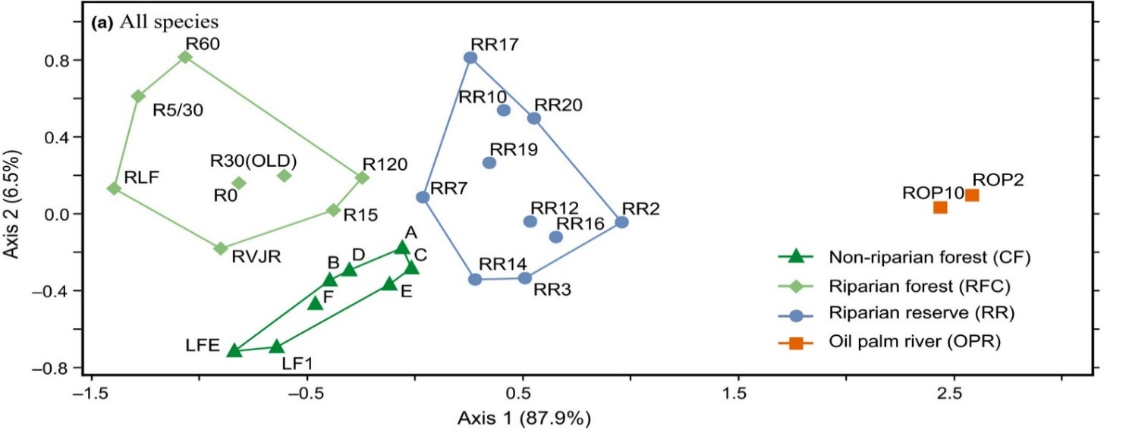
Brief intro to some common statistical tests - an example of an exploratory approach
Test | What’s it for? | Type of data? | Test statistic | Null hypothesis | Notes
Ordination | For exploring patterns in multivariate data Techniques that summarise multidimensional data sets (e.g. community data) in a way that allows patterns in the data to become visible in 2D, i.e. on a plot Species and samples that show similar patterns in the data set are plotted close together, and dissimilar ones are plotted further apart Can also plot environmental variables to indicate how community changes in relation to environmental conditions Examples include: Principal Component Analysis (PCA) Principal Coordinate Analysis (PCoA) Non-metric Multidimensional Scaling (NMDS)
Mitchell et al. 2018
Luke et al. 2014

Slide 55
Statistical programs
Some examples of possible options
Package name | Style | Pros? | Cons?
Excel | ‘Point and click’ | Easy to use interface, and you are likely to already be very familiar with how to use it | Very limited range of statistical tests available ‘Point and click’ means that re-runs are time-consuming
e.g., GenStat, SPSS, Minitab, Canoco | ‘Point and click’ | Relatively easy to use interfaces, and you may already have some familiarity with using these Likely that they have more options for graphs and tests than in Excel | Not as wide a range of options as R ‘Point and click’ means that re-runs are time-consuming
R | Coding-based | A huge range of options for how to plot and analyse your data Once you’ve developed the code for an analysis, it can be tweaked and re-run very quickly | Less likely that you have used this before Coding-based interface could take some time to get used to if you haven’t used it before, and so will require some time investment

Slide 56
Statistical programs
Some examples of possible options
Package name | Style | Pros? | Cons?
Excel | ‘Point and click’ | Easy to use interface, and you are likely to already be very familiar with how to use it | Very limited range of statistical tests available ‘Point and click’ means that re-runs are time-consuming
e.g., GenStat, SPSS, Minitab, Canoco | ‘Point and click’ | Relatively easy to use interfaces, and you may already have some familiarity with using these Likely that they have more options for graphs and tests than in Excel | Not as wide a range of options as R ‘Point and click’ means that re-runs are time-consuming
R | Coding-based | A huge range of options for how to plot and analyse your data Once you’ve developed the code for an analysis, it can be tweaked and re-run very quickly | Less likely that you have used this before Coding-based interface could take some time to get used to if you haven’t used it before, and so will require some time investment

Slide 57
Statistical programs
Some examples of possible options
Package name | Style | Pros? | Cons?
Excel | ‘Point and click’ | Easy to use interface, and you are likely to already be very familiar with how to use it | Very limited range of statistical tests available ‘Point and click’ means that re-runs are time-consuming
e.g., GenStat, SPSS, Minitab, Canoco | ‘Point and click’ | Relatively easy to use interfaces, and you may already have some familiarity with using these Likely that they have more options for graphs and tests than in Excel | Not as wide a range of options as R ‘Point and click’ means that re-runs are time-consuming
R | Coding-based | A huge range of options for how to plot and analyse your data Once you’ve developed the code for an analysis, it can be tweaked and re-run very quickly | Coding-based interface can take some time to get used to if you haven’t used it before.

Slide 58


Statistics in R
The rest of this workshop will focus on getting started with using R, and a commonly used ‘interface’ program called Rstudio
We will work through a series of tutorials to practice several key stages of data analysis
Loading and organising data
Plotting graphs
Conducting statistical analyses
As with all statistics programs - R cannot tell you how to organise your data, plot graphs, or what statistical tests you should carry out – you will need to decide this based on many of the ideas discussed in this lecture
But, R can provide you with an incredibly wide range of tools and options
We’ll be around all day Friday, and also Saturday morning, and we’re also available over email after that too, to try and answer any questions you have as you work through the tutorials ☺

Slide 59
Summary
A reverse planning approach can help to ensure that studies are appropriately designed to answer the question, with the resources that are available
Key steps include thinking about what data are needed by planning graphs and statistics, what protocols are appropriate, doing preliminary tests, and then making adjustments
You want to ensure that your sampling design is reliable and representative. Best choice for study methods depends on your objectives, your study system, the biases of potential methods, and the resources you have available for your study
Consider approaches for surveying organisms, ecosystem functions, and environmental variables
Choosing the statistical test to use depends on - your question, your basic types of data, and more specific details about your data set
Plotting and trying statistics with dummy data can be very helpful
Decision trees can be useful starting point for learning about possible test options
Key ideas in frequentist stats – the null and alternate hypotheses, test statistics, p-values. Don’t forget effect size.
Common approaches include - tests of difference, including parametric and non-parametric options; tests of relationships; and ordination as a data exploration technique
Packages for carrying out statistical tests – huge flexibility of R

Slide 60

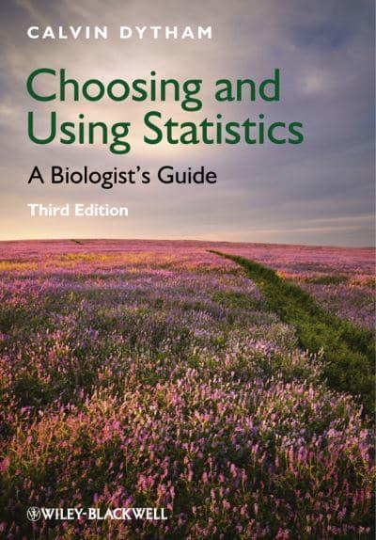
References
Key texts:
Ecological Census Techniques, Second Edition, 2006, Edited by William J. Sutherland. Cambridge University Press
Choosing and Using Statistics: A Biologist’s Guide, 3rd Edition. Calvin Dytham, 2010. Wiley-Blackwell.
Some other books that you might find helpful:
A Beginner’s Guide to Data Exploration and Visualisation with R. Elena N Ieno and Alain F Zuur, 2015. Highland Statistics Ltd.
Introductory Statistics with R. Peter Dalgaard, 2008. Springer.
Regression and Other Stories. Andrew Gelman, Jennifer Hill, Aki Vehtari, 2020. Cambridge University Press.
Numerical Ecology with R. Daniel Borcard, Francois Gillet, Pierre Legendre, 2018. Springer.
Papers that ordination examples were taken from (in case you wanted to check details about the analyses):
Luke SH et al. (2014) Functional structure of ant and termite assemblages in old growth forest, logged forest and oil palm plantation in Malaysian Borneo. Biodivers. Conserv. 23:2817–2832
Mitchell SL et al. (2018) Riparian reserves help protect forest bird communities in oil palm dominated landscapes. J Appl Ecol.

Slide 61
Thank you Any questions? sarah.luke@nottingham.ac.uk

